Slide 1
MATHEMATICAL FOUNDATION FOR COMPUTER SCIENCE
Prepared by: Er. Ankit Kharel
Nepal college of information technology

Slide 2
Tautology
Contradiction
contingency
Propositional satisfiability
Logical equivalence

Slide 3
TAUTOLOGY:
Compound proposition that is always TRUE , not matter what the truth values of the propositional variables that occur in it, is called TAUTOLOGY.
Examples:
a) p V ¬p b) (p→q) v (q→p)
p | ¬p | p ^ ¬p
T | F | T
F | T | T
p | q | p→q | q→p | (p→q)V(q→p)
T | T | T | T | T
T | F | F | T | T
F | T | T | F | T
F | F | T | T | T

Slide 4
CONTRADICTION:
Compound proposition that is always FALSE, not matter what the truth values of the propositional variables that occur in it, is called CONTRADICTION.
Examples:
a) p ^ ¬p b) ¬(p^q) ←→ (q^p)
p | ¬p | p ^ ¬p
T | F | F
F | T | F
p | q | (p ^ q) | ¬(p^q) | (q^p) | ¬(p^q) ←→ (q^p)
T | T | T | F | T | F
T | F | F | T | F | F
F | T | F | T | F | F
F | F | F | T | F | F

Slide 5
CONTINGENGY:
Compound proposition that is neither a TAUTOLOGY or a CONTRADICTION
Examples:
a) (p → q) ∧ (q → p)
p | q | p→q | q→p | (p→q) ^ (q→p)
T | T | T | T | T
T | F | F | T | F
F | T | T | F | F
F | F | T | T | T

Slide 6
SATISFIABILITY:
Compound proposition is satisfiable is there is at least one true value in its truth table.
TAUTOLOGY is always satisfiable but satisfiable is not always TAUTOLOGY.
(p→q) ^ (q→p)
(p→q)V(q→p)
p | q | p→q | q→p | (p→q) ^ (q→p)
T | T | T | T | T
T | F | F | T | F
F | T | T | F | F
F | F | T | T | T
p | q | p→q | q→p | (p→q)V(q→p)
T | T | T | T | T
T | F | F | T | T
F | T | T | F | T
F | F | T | T | T
SATISFIABLE but not TAUTOLOGY
SATISFIABLE and alsoTAUTOLOGY

Slide 7
UNSATISFIABILITY:
Compound proposition is unsatisfiable is there is no true value in its truth table.
CONTRADICTION is always unsatisfiable.
¬(p^q) ←→ (q^p)
p | q | (p ^ q) | ¬(p^q) | (q^p) | ¬(p^q) ←→ (q^p)
T | T | T | F | T | F
T | F | F | T | F | F
F | T | F | T | F | F
F | F | F | T | F | F

Slide 8
VALID & INVALID:
VALID: Compound proposition always VALID when it is a TAUTOLOGY.
INVALID: Compound proposition always INVALID when it is either CONTRADICTION or CONTINGENCY.
SUMMARY
CONTRADICTION
Always FALSE
unsatisfiable
INVALID
CONTINGENCY
Sometimes TRUE or FALSE
Satisfiable
INVALID
TAUTOLOGY
Always TRUE
Satisfiable
VALID

Slide 9
LOGICAL EQUIVALENCES:
Compound proposition ‘p’ and ‘q’ are logically equivalent is they have
same Truth Values in all possible cases.
Notation: p ≡ q or p ⇔ q
Examples:
a) ¬(p V q) and (¬p ^ ¬q)
p | q | (pVq) | ¬(pVq) | ¬p | ¬q | (¬p^¬q)
T | T | T | F | F | F | F
T | F | T | F | F | T | F
F | T | T | F | T | F | F
F | F | F | T | T | T | T
Hence, ¬(p V q) ⇔(¬p ^ ¬q)

Slide 10
Examples:
b) (p→q) and (¬p V q)
p | q | (p→q) | ¬p | (¬pVq)
T | T | T | F | T
T | F | F | F | F
F | T | T | T | T
F | F | T | T | T
Hence, (p→q) ⇔ (¬p V q)

Slide 11
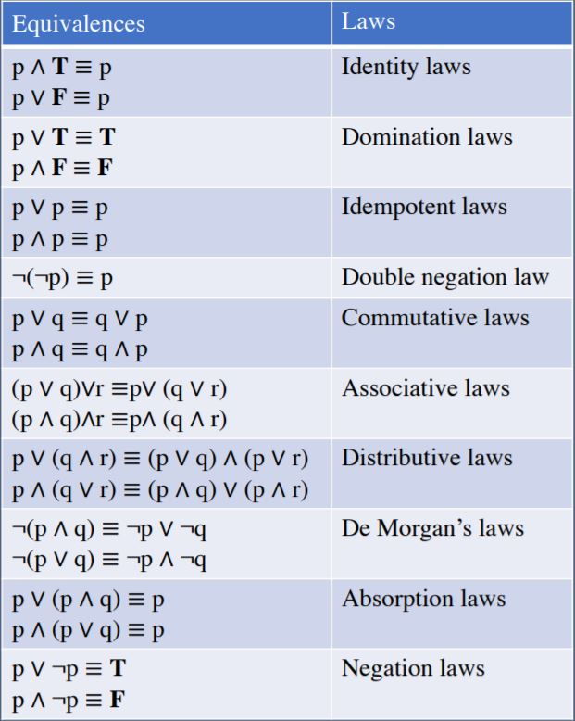
IMPORTANT EQUIVALENCE:
p | T | p ^ T
T | T | T
F | T | F
p | F | p V T
T | F | T
F | F | F
1. Identity Laws
p | T | p V T
T | T | T
F | T | T
p | F | p ^ F
T | F | F
F | F | F
2. Domination Laws

Slide 12
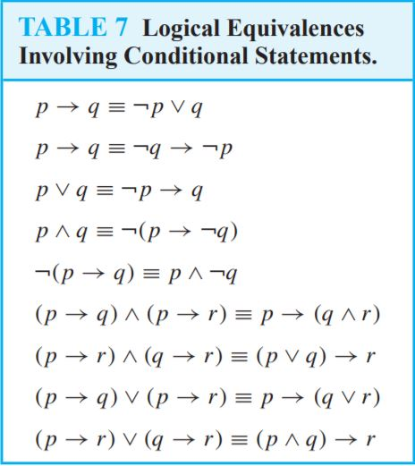
EQUIVALENCE INVOLVING CONDITION:
1. (p→q )⇔ (¬p v q)
p | q | (p→q) | ¬p | (¬pVq)
T | T | T | F | T
T | F | F | F | F
F | T | T | T | T
F | F | T | T | T
(Implication)
(contra-positive)
2. (p→q) ⇔ (¬q→ ¬p)
p | q | (p→q) | ¬p | ¬q | (¬q→ ¬p)
T | T | T | F | F | T
T | F | F | F | T | F
F | T | T | T | F | T
F | F | T | T | T | T

Slide 13
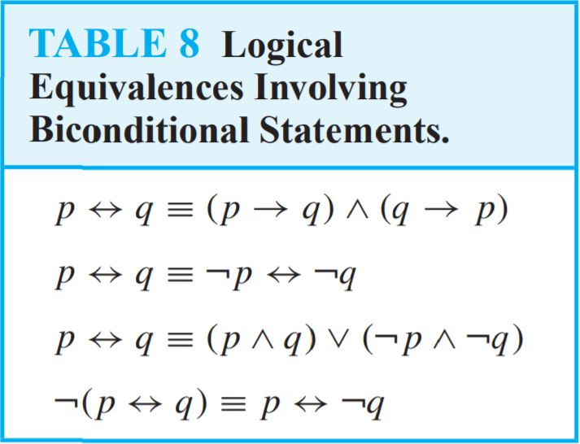
EQUIVALENCE INVOLVING BICONDITION:
1. (p←→q) ⇔ (p→q)^(q→p)
p | q | (p←→q) | (p→q) | (q→p) | (p→q)^(q→p)
T | T | T | T | T | T
T | F | F | F | T | F
F | T | F | T | F | F
F | F | T | T | T | T

Slide 14
Prove the following are logically equivalent by developing a series of logical equivalence.
¬(p→q) ≡ (p^¬q)
solution:
Taking LHS,
=¬(p→q)
=¬(¬pvq)----------{p→q ≡¬pvq}
= ¬(¬p)^(¬q)-----{De- Morgan's Law}
=p^¬q--------------{Double Negation Law}

Slide 15
Prove the following are logically equivalent by developing a series of logical equivalence.
¬(pV(¬p^q)) ≡ (¬p^¬q)
solution:
Taking LHS,
=¬(pV(¬p^q))
=¬p ∧ ¬(¬p ∧ q) ------------------by the second De Morgan law
= ¬p ∧ [¬(¬p) ∨ ¬q] --------------------by the first De Morgan law
= ¬p ∧ (p ∨ ¬q) -----------------------by the double negation law
= (¬p ∧ p) ∨ (¬p ∧ ¬q) -----------by the second distributive law
= F ∨ (¬p ∧ ¬q) ------------------------------------because ¬p ∧ p ≡ F
= (¬p ∧ ¬q) ∨ F--------- by the commutative law for disjunction
= ¬p ∧ ¬q ---------------------------------------by the identity law for F

